Slide 1
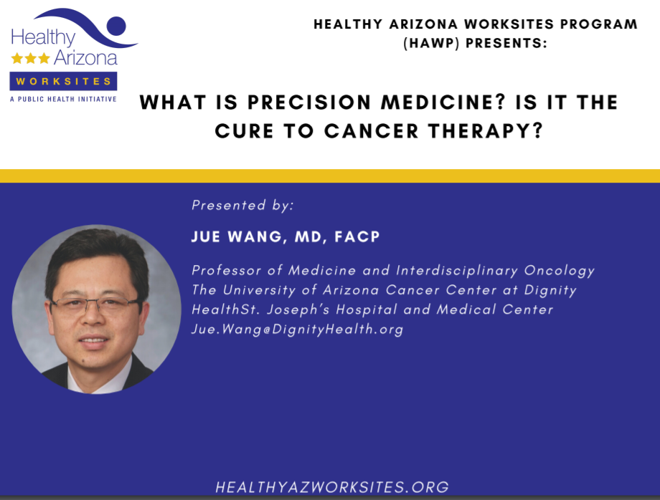

Slide 2



Slide 3


Slide 4



Slide 6


Slide 7
New Paradigms in the Treatment of Head & Neck Cancers
Aidnag Z. Diaz MD-MPH
Professor and Medical Director
Department of Radiation Oncology
UACC at St. Josephs Medical Center
April 16,2020

Slide 8
Head and Neck Cancer Burden
Worldwide:
  600,000 cases a year
  350,000 deaths a year
US 2016:
  61,760 cases
  13,190 deaths
Arizona:1200 new cases

Slide 9
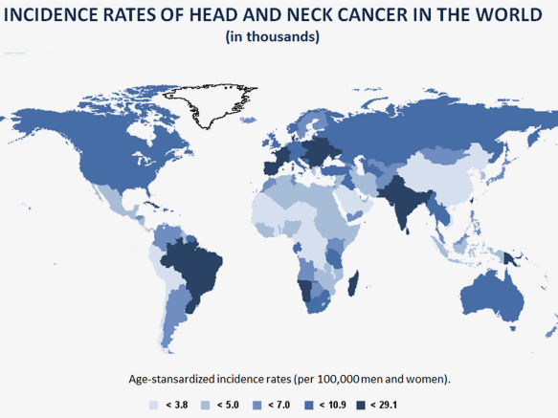
Gillison, 2013.

Slide 10
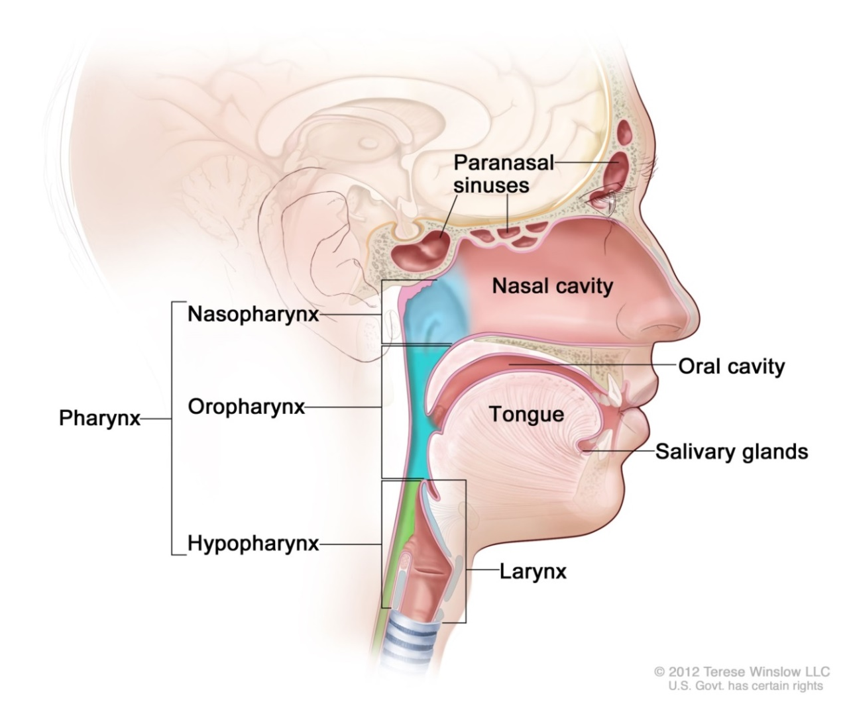
Head and Neck Cancer
Paranasal sinus
Nasopharynx
Oral cavity
Pharynx
  Oropharynx
  Hypopharynx
  Larynx
Salivary glands

Slide 11
Common Presenting Symptoms for Head and Neck Cancer
Oral pain or sore throat
Ulcer or mass
Dysphagia or odynophagia
Hoarseness
Dyspnea
Headache or ear pain
Sinus congestion or bleeding
Neck mass

Slide 12
Established Risk Factors
Tobacco use
Alcohol use
HPV
Oral hygiene
Diet
Family history
Age, gender, race
Notes:
Shown here are the major, established risk factors for head and neck cancer. It should be noted that head and neck cancers are a disease caused largely by modifiable risk factors. Tobacco is the predominant cause. All forms of tobacco, including cigarettes, cigars, pipe and smokeless tobacco increase risk. Risk increases with amount and duration of use. Even smoking 1-3 cigarettes a day increases risk by 50% (Berthiller J Int J Epidemiol 2016). Oral HPV infection a newly established risk factor, and oral HPV16 infection confers an approximate 20-fold increase in risk. Good oral hygiene and diets high in fruit and vegetables and low in cured or processed meats are protective. Very few genetic syndromes are associated with risk of head and neck cancer, for example, Fanconi Anemia and Diamond Blackfan Anemia.

Slide 13
Tobacco Use
Population Attributable Risk (PAR), Oral Cancer, France
Risk Factor | PARª (%) | 95% CI
Alcohol alone | 0.3 | -3.0-3.9
Tobacco alone | 12.7 | 6.9-18.0
Tobacco and alcohol | 69.9 | 64.4-74.7
Tobacco and/or alcohol | 82.9 | 73.8-88.5
Adjusted for gender, age, BMI, education, exercise, family history of HNC, alcohol, residence, history of candidiasis, tea drinking.
CI = confidence interval; BMI = body mass index; HNC = head and neck cancer.
Radoi et al, 2015.

Slide 14
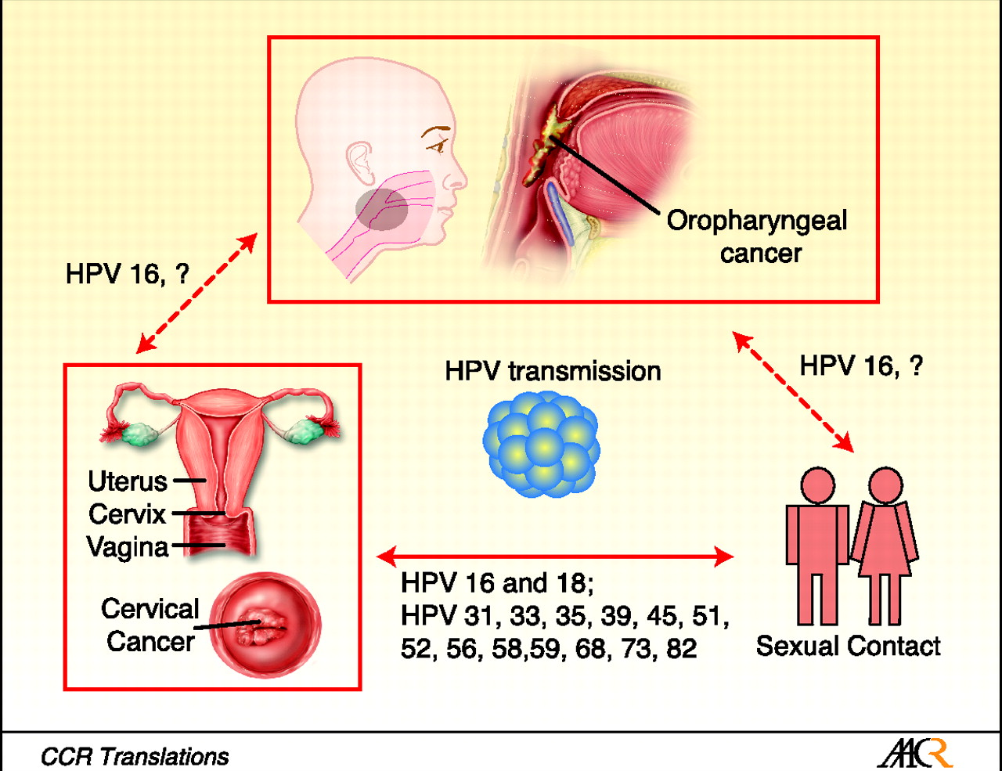
HPV is a prevalent sexually transmitted disease

Slide 15
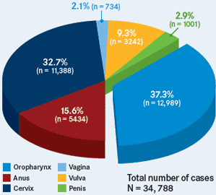
HPV is prevalent in many malignancies

Slide 16
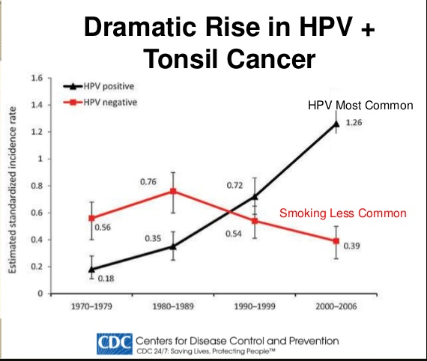

Slide 17
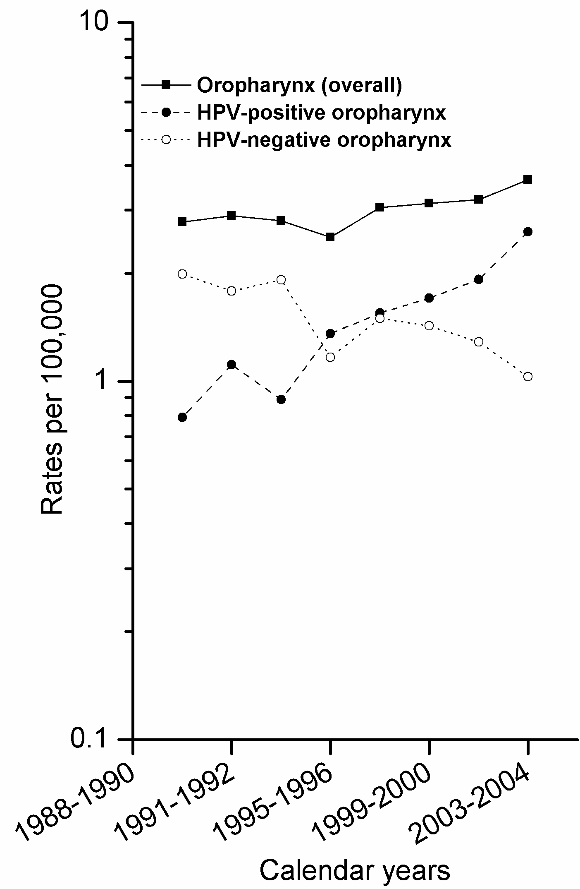
Rapidly Changing Incidence of
HPV-Positive vs HPV-Negative HNC
Oropharynx rates increasing overall
HPV-positive increased by 225%
HPV-negative declined by 50%
Chaturvedi et al, 2011; Chaturvedi et al, 2013.

Slide 18
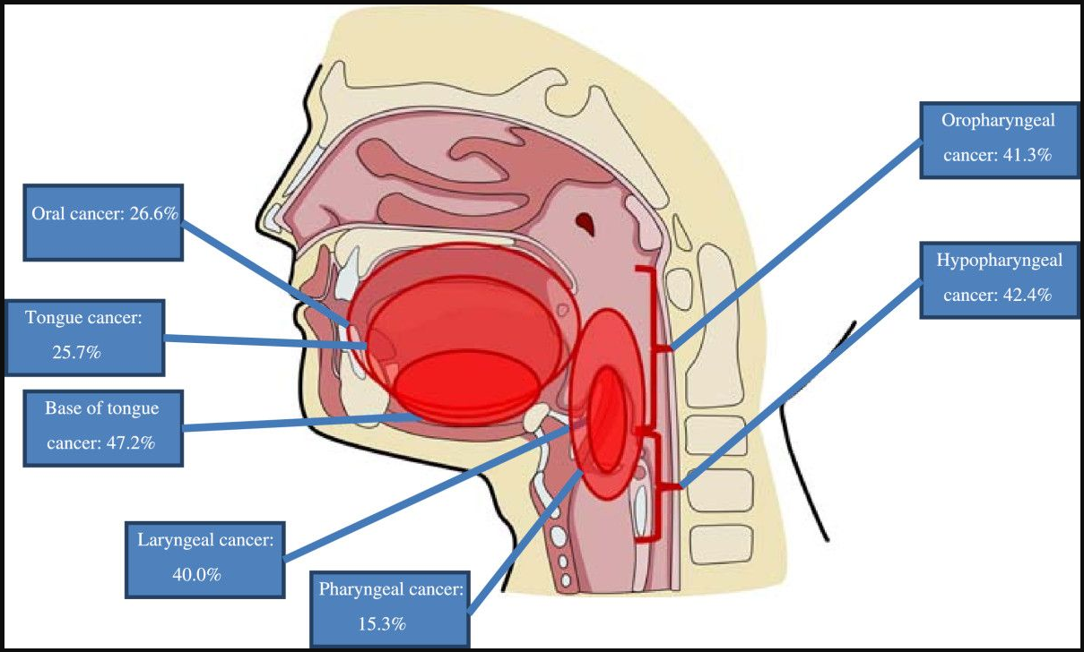

Slide 19
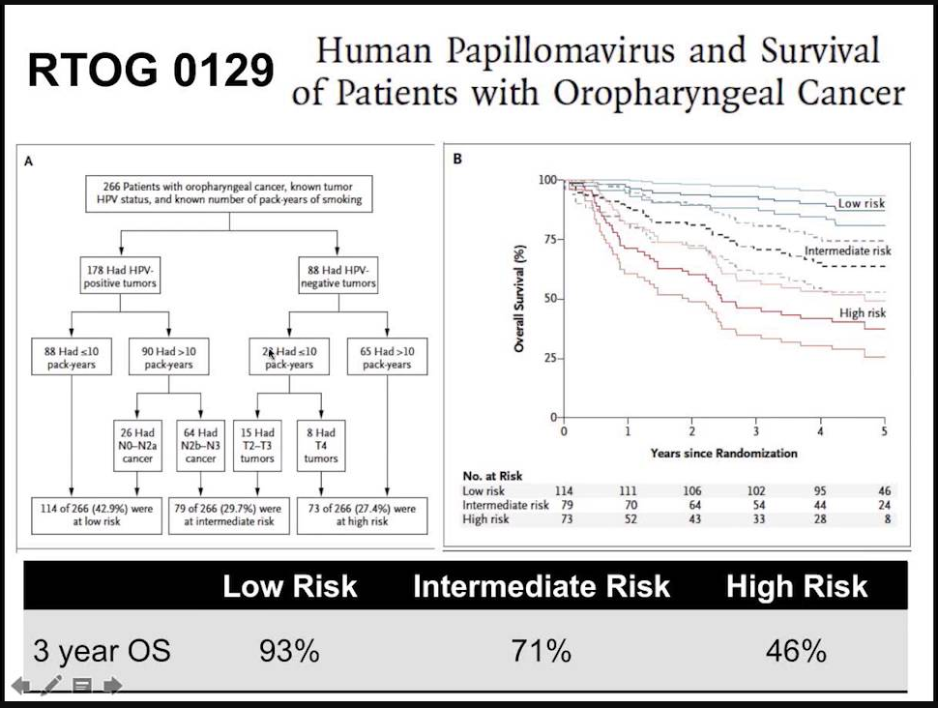

Slide 20
Prognostic Factors
Age
Race
Performance status
Comorbidity
HPV status
Weight loss
Anemia
Smoking status
Social support

Slide 21
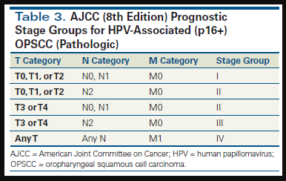

Slide 22
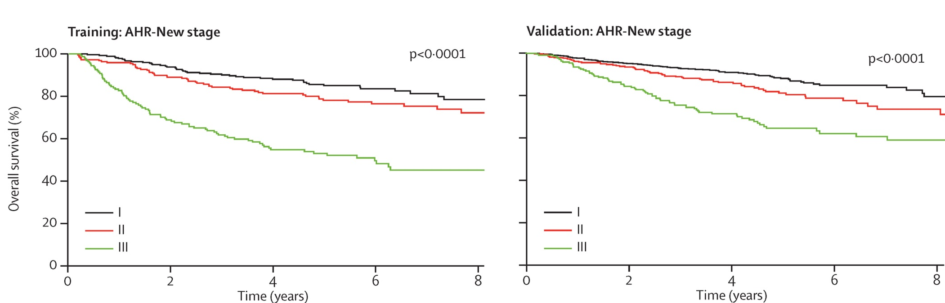
HPV-Positive HNC
8th Edition AJCC Staging
Associations between 8th Edition AJCC Staging and OS in training (left) and validation (right) data sets.
AHR = adjusted hazard ratio.
O’Sullivan et al, 2016

Slide 23
De-escalation of therapy for HPV+ patients
NRG-HN-002 included 308 patients in a phase II parallel-arm design investigating de-intensification in a low-risk p16+ population (T1–2 N1-N2b or T3 N0-N2b as per AJCC 7th edition, and ≤ 10 pack-year smoking history). Arm 1 was conventionally fractionated CRT with 60 Gy (2 Gy/fraction) given in 6 weeks with weekly cisplatin 40 mg/m2 and Arm 2 was accelerated RT alone with 60 Gy (2 Gy/fraction) given in 5 weeks with 6 fractions per week. The trial had co-primary endpoints with progression-free survival (PFS) and QOL at 2 years with acceptability criterion of PFS of ≥85% and an MD Anderson Dysphagia Inventory (MDADI) score ≥ 60. Early results presented in abstract format showed the CRT arm met the acceptability criteria for both PFS and MDADI, while the accelerated radiotherapy arm did not meet the PFS acceptability criterion.

Slide 24

Trans Oral Robotic Surgery (TORS)

Slide 25
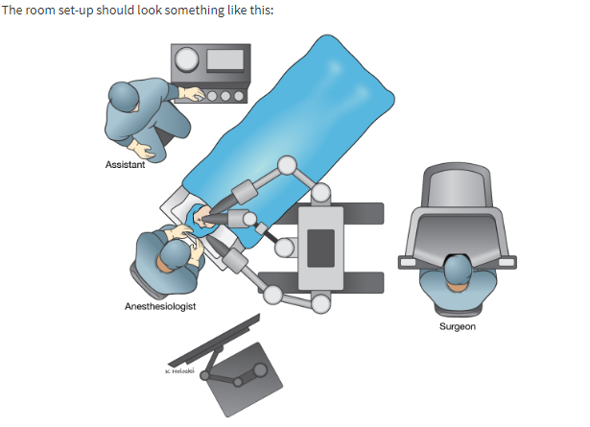
Room Setup

Slide 26
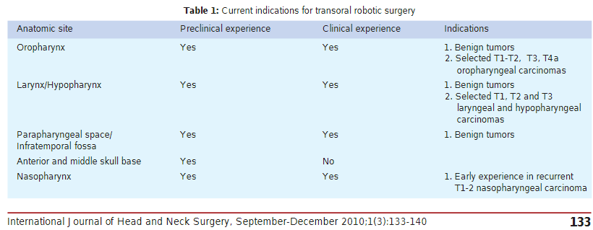

Slide 27
TORS vs. Chemo-radiation
Oncologic outcomes and patient-reported quality of life in patients with oropharyngeal squamous cell carcinoma treated with definitive transoral robotic surgery versus definitive chemoradiation
D.C.LingMDªB.V.ChapmanMDªJ.KimMD^{b}G.W.ChobyMD^{b}P.KabolizadehMD, PhDªD.A.ClumpMD, PhDªR.L.FerrisMD, PhD, FACS^{b}S.KimMD^{b}S.BeriwalMDªD.E.HeronMD, FACRO, FACR^{ab}U.DuvvuriMD, PhD^{b}
ªDepartment of Radiation Oncology, University of Pittsburgh Cancer Institute, Pittsburgh, PA, United States
^{b}Department of Otolaryngology, University of Pittsburgh Medical Center, Pittsburgh, PA, United States
Received 9 June 2016, Revised 29 July 2016, Accepted 17 August 2016, Available online 25 August 2016.

Slide 28
TORS vs. Chemo-radiation
Highlights
•CRT and definitive TORS offer similar oncologic outcomes in early stage OPSCC.
•TORS resulted in improved short and long-term saliva-related QOL compared to CRT.
•Use of adjuvant therapy after TORS lead to worse saliva and taste-related QOL.
•Difficult to determine a priori which patents will not be subjected to adjuvant therapy after TORS.

Slide 29
TORS vs. Chemo-radiation (Conclusion)
Definitive CRT and definitive TORS offer similar rates of loco-regional control, overall survival, and disease-free survival in patients with early stage OPSCC. TORS resulted in significantly better short and long-term saliva-related QOL, whereas adjuvant therapy was associated with worse saliva and taste-related QOL compared to TORS alone.

Slide 30
Immunotherapy for H&N Cancer
Patients with platinum-refractory R/M HNSCC have a dismal prognosis, with median overall survival ≤6 months
  No anticancer agent improves survival for this patient population
  No new treatments have been approved in >10 years
HNSCC recurrence and metastasis are facilitated by immune evasion mediated by PD-L1 and PD-L2
Both HPV-positive and HPV-negative HNSCC frequently express PD-L1
R/M = recurrent/metastatic.
Herbst et al, 2015; Ferris, 2015; Badoual et al, 2013; Concha-Benavente et al, 2015.

Slide 31
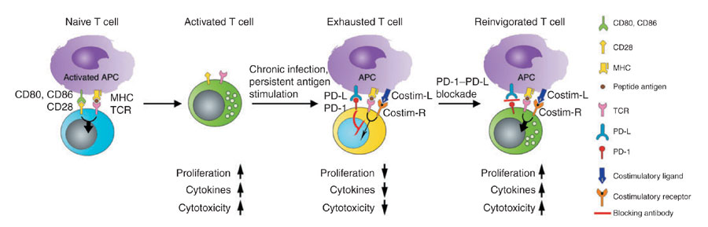
Blocking PD-1/PD-L1 Restores
T-Cell Function
Sharpe et al, 2007.

Slide 32
PD-1 Inhibitor Therapy for HNC
Nivolumab improved survival for patients with platinum-refractory HNC
1-year survival more than doubled compared with single-agent SOC options (docetaxel, methotrexate, or cetuximab)
All demographic and clinical subgroups appeared to benefit
The magnitude of the benefit appeared greatest for patients with PD-L1 >1% and HPV-positive tumors
PFS was not significantly different with nivolumab vs SOC
Response rates were higher with nivolumab vs SOC
Toxicity was less with nivolumab
Nivolumab stabilized QOL in comparison to worsening QOL with SOC
Pembrolizumab and nivolumab are now FDA approved for this indication
SOC = standard of care.
QOL = quality of life.
Ferris et al, 2016.

Slide 33
Key Takeaways
HPV is prevalent in many malignancies
HPV is changing the clinical landscape of HNC
TORS is a minimally invasive surgical option but we are still trying to determine the group of patients where this modality is best deployed.
Be aware of the new staging system specific to
HPV-positive oropharynx cancer since the old staging system is not prognostic.
PD1 inhibitor therapy results in clinical response and improved OS (nivolumab only) for patients with Recurrent/Metastatic platinum-refractory HNC with a trend of preferential improved control for HPV positive patients.

Slide 34
Thank You

