Slide 1
Healthy Arizona Worksites Program (HAWP) Presents
Infant at Work
www.healthyazworksites.org
Notes:
Welcome from Denise Lopez.

Slide 2
Today’s Topics
Examples of policies, procedures and guidelines
How to obtain leadership support
Support and education for employees
Successes and opportunities for improvement
1

Slide 3
Program Benefits
Earlier return to work after baby’s birth
Increased employee retention
Higher morale
Increased teamwork
Increased efficiency from parent – participants
Recruiting tool
www.azdhs.gov/prevention/nutrition-physical-activity/breastfeeding/infant-at-work
1
Notes:
Program Benefits
The ADHS Infant at Work Program is meant to provide a positive work environment that recognizes a parent’s/caregiver’s responsibility to both their job and their infant, by acknowledging that when a parent is able to stay with their infant, it benefits the family, the employer, and society. Here are some of the many benefits.
For more resources please go to Arizona Department of Health Services website.

Slide 5
infants At work in gilbert
Kristen Drew, Benefits Manager

Slide 6
Policies & procedures
Research
Adapt to Gilbert
Educate
Listen
Implement
Notes:
We learned about this program while working on our wellness program. We researched the program that the State offices have, and adjusted for Gilbert’s needs. We also reached out to the Parenting in the Workplace Institute, and any other resources we could find. We listened to concerns and made sure we addressed them in our guidelines. We met with all levels of leadership to roll this out. Using pictures of cute babies helps, but having feedback from new moms as well as parents who had a similar benefit at other organizations helped more.

Slide 7
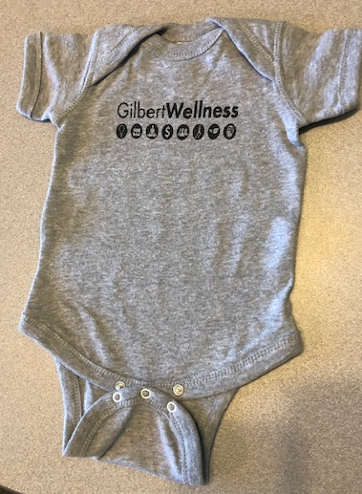
Leadership support
“We intend to create a tranquil space for mom and baby.”
– Police Commander
Notes:
Leadership support is critical and we rolled out our program to every employee, with the attitude of we’ll try to make it work, regardless of the position. The first two babies are to patrol officers and the PD Command Staff was very supportive with how to make it work, and making sure they felt welcome! Open dialogue is very important to acknowledge concerns and say we will address them with the intent of making it work.

Slide 8
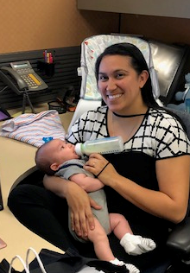
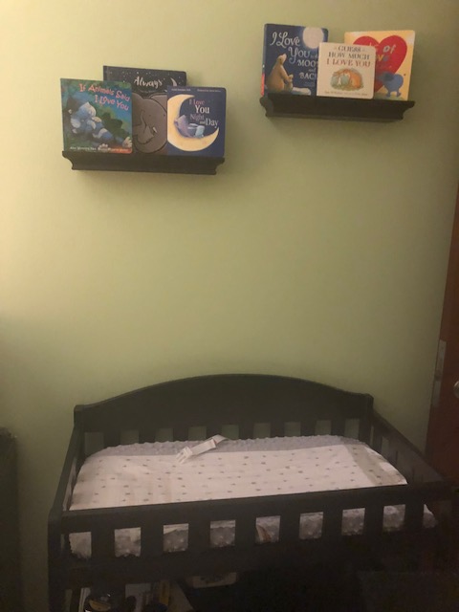
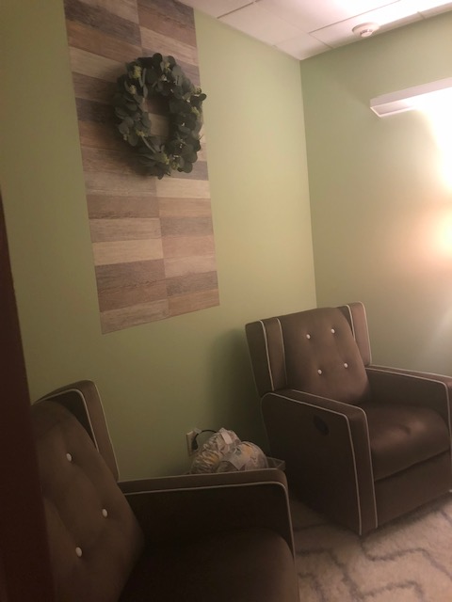
Organizational support
Our first Baby at Work!
Notes:
Our first baby started on 4/15/19 in PD. Jesse’s mom is a patrol officer but will help out in the Training Division until Jesse retires in July. PD was so supportive they spruced up the old Stand-By Room so Mom and Baby would have that tranquil space and feel welcome! Our second baby is scheduled to start in July, also in PD.

Slide 9
Education for employees
Guidelines
Things to consider
Resources
Support
Positive Attitude
Notes:
We gathered information with local and regional resources for parents, and also communicated with all employees that this is something new, and there may be bumps in the road, but we are smart compassionate people and we can figure it out. Share the perspective of the bigger picture – we care about our employees and maybe this is not your need, but we will give equal consideration to whatever your need is.

Slide 10
Barriers to overcome
Noise/Chaos
Distracted Co-workers
Extra Work
It won’t work in our area
We choose a “can do” attitude!
Notes:
Perceptions and reasons why not are the hardest thing to overcome. We are known for being a family-oriented community and once we said we are doing this and the ask is that you approach it with the intent of making it successful, we really saw some positive reaction. We know new parents are tired, and distracted, in any situation. Why not try to make that transiition back to work an easier one?

Slide 11
Putting Work-Family Policies into Practice Adrienne Z. Udarbe, MS, RDN

Slide 12
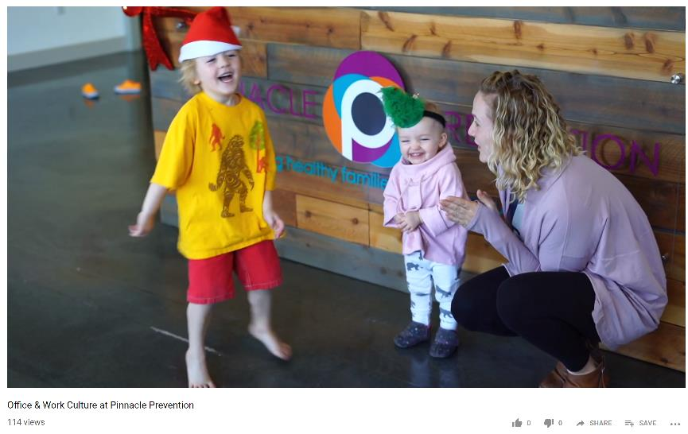
https://www.youtube.com/watch?v=_enfRpvL8f4

Slide 13
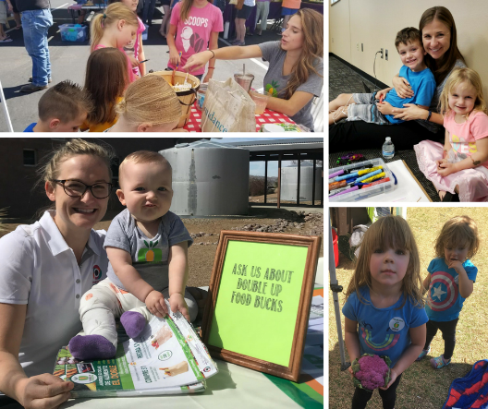
Champions of Work-Family Justice
“Work-family conflict is the product of public policies and cultural attitudes that must change if we are to improve the lives of mothers and their families.”
– Caitlyn Collins,
Making Motherhood Work

Slide 14
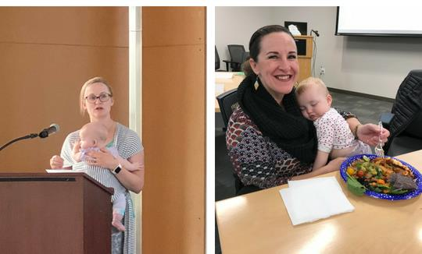
Employee Support and Education What This Looks Like for Us
Policies that reflect:
Flexible schedules: Home and in-office
Paid family leave
Breastfeeding support

Slide 15
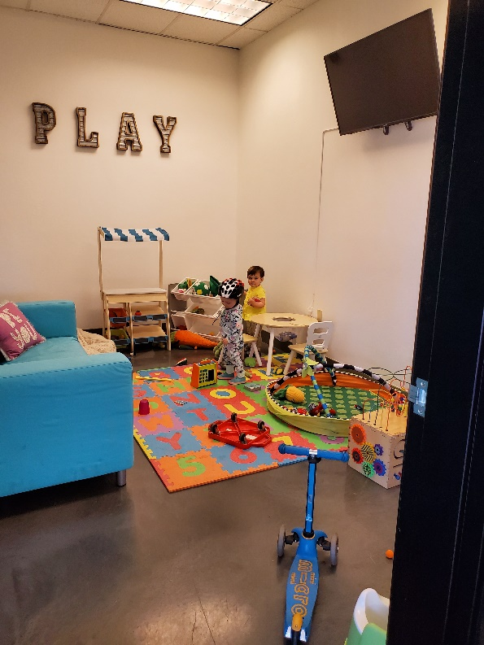
Barriers and Successes
It starts with leadership support and your culture
Trust employees and trust the process

Slide 16
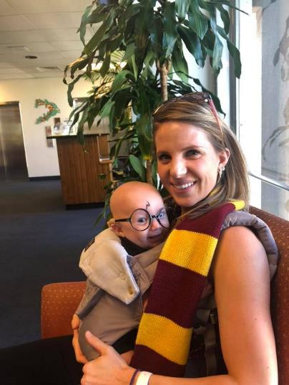
“Work-family conflict is a phenomenon that societies have created, which means that societies can change it too.” – Caitlyn Collins

Slide 18
Thank you!

Slide 19
Thank you!
www.healthyazworksites.org

