Slide 1

Lactation Accommodations
in the Workplace
Presented By Jessa Zuck, ASU Dietetic Intern
April 5th, 2016

Slide 2

Today’s Agenda
Presenter:
Jessa Zuck, Dietetic Intern
Arizona State University- Nutrition MS Graduate Student
Maricopa County Department of Public Health Intern
Overview:
  Benefits of breastfeeding for baby, employee (mom), and employer
  Federal Laws related to breastfeeding and lactation accommodations in the workplace
  Strategies for implementing a comprehensive lactation program
  Resources available for both employers and employees

Slide 3

Making the Case for Breastfeeding

Slide 4

Babies are born to breastfeed
  It’s a natural process
  Babies are born with the “root” and “suck” reflexes to aid in breastfeeding
  Human milk is easy to digest
  Human milk contains more than 200 components that babies need in early life
  Numerous other benefits!

Slide 5

Benefits of Breastfeeding
  Health
  Psychosocial
  Economic
  Environmental

Slide 6

Benefits of Breastfeeding
  Baby
      Decreased risk of childhood cancers and Type I Diabetes
      Decreased risk of dying from Sudden Infant Death Syndrome (SIDS)
      Fewer ear infections, respiratory infections, stomach issues, digestive problems, and allergies
      Decreased risk of becoming overweight or obese
      Higher IQ
      Emotional bonding with mother

Slide 7

Benefits of Breastfeeding
  Baby
  Mom (employee)
      Faster recovery from pregnancy and childbirth
      Reduced risk of breast and ovarian cancer
      Reduced risk of osteoporosis
      Less likely to develop diabetes and cardiovascular disease throughout life
      Delay return of menstrual period (natural contraceptive)
      Cost-effective
      Emotional bonding with baby

Slide 8


Did you Know? Lactation accommodations in the workplace produce a 3 to 1 return on investment
Benefits of Breastfeeding
  Baby
  Mom (employee)
  Employer
      Lower health care costs (healthier babies and moms)
      Reduced rate of absenteeism due to infant illness (for both mothers and fathers)
      Lower employee turnover rates
      Improved employee productivity and loyalty

Slide 9






Advocates for breastfeeding include:
  American Academy of Pediatrics (AAP)
  American Academy of Family Physicians
  American College of Obstetricians and Gynecologists
  American College of Nurse- Midwives
  Academy of Nutrition and Dietetics
  American Public Health Association

Slide 10

Rates of Breastfeeding in the US
  *Data obtained from the 2013 CDC Breastfeeding Report Card
  76.5% of infants are ever breastfed*
  37.7% of infants are exclusive breastfeeding at 3 months*
  16.4% of infants are exclusive breastfeeding at 6 months*
Did you Know? In Arizona, 83.2% of infants are ever breastfed, but only 15% of infants are exclusively breastfed at 6 months.*

Slide 11

Barriers to breastfeeding
  Employment and child care
  Lack of knowledge
  Social norms
  Poor family and social support
  Embarrassment
  Lactation problems
  Health services
  Inflexibility in work hours
  Lack of privacy
  No place to store expressed milk
  Limited maternity leave
  Unable to find child care facility near workplace
  Unaccepting supervisors or co-workers

Slide 12
Federal Law
Affordable Care Act signed by President Obama on March 30, 2010 amended Section 7 of the Fair Labor Standards Act (FLSA) of 1938
    The employer must provide reasonable break time for an employee to express breast milk for her nursing child for one year after the child's birth each time such employee has need to express milk
    The employer must also provide a place, other than a bathroom, for the employee to express breast milk that is shielded from view and free from intrusion from co-workers and the public

Slide 13
Making Breastfeeding Happen

Slide 14

US Surgeon General’s Call to Action to Support Breastfeeding (2011)
  Mothers and their Families
  Communities
  Health Care
  Employment
  Research and Surveillance
  Public Health Infrastructure

Slide 15

US Surgeon General’s Call to Action to Support Breastfeeding (2011)
  Employment
    Action 13: Paid maternity leave
    Action 14: Workplace lactation support programs
    Action 15: Direct access to their babies at work
    Action 16: Child care providers accommodate breastfeeding mothers

Slide 16
Simple Steps to Compliance:
  Discuss the needs of nursing women in your workplace
  Develop a plan to address those needs
  Contact community resources for assistance, including local breastfeeding coalition or public health department
  Review your company policies and revise as needed
  Identify space and time options that comply with the law
  Train supervisors and coworkers on the laws and company policies
  Promote your lactation support services

Slide 17

Simple Steps to Compliance:
  Discuss the needs of nursing women in your workplace
Basic needs: time, private space, support
Set a standard that will encompass the needs of each individual
Have an open-dialogue between supervisors/managers and lactating mothers

Slide 18

Simple Steps to Compliance:
  Develop a plan to address those needs
Time
Allow 20 minutes to pump/nurse every 3 hours at a minimum
Private Space
Designate a private space for lactation
Support
Inform nursing mothers of policies and their options prior to maternity leave
Set the right tone in the office

Slide 19

Simple Steps to Compliance:
  Contact community resources for assistance, including local breastfeeding coalition or public health department
Get your free “Making it Work” toolkit online at http://makingitworkarizona.org
Arizona Department of Health Services
Maricopa County Department of Public Health
Women, Infants, and Children (WIC)
AZ Breastfeeding Coalition
La Leche League of Arizona

Slide 20

Making it Work Toolkit:
Contents-
  1 Overview booklet
  3 pamphlets
    Managers/HR
    The Employee
    The Co-Worker
  Breastfeeding-friendly sign
  Privacy door hanger
Order online at http://makingitworkarizona.org

Slide 21
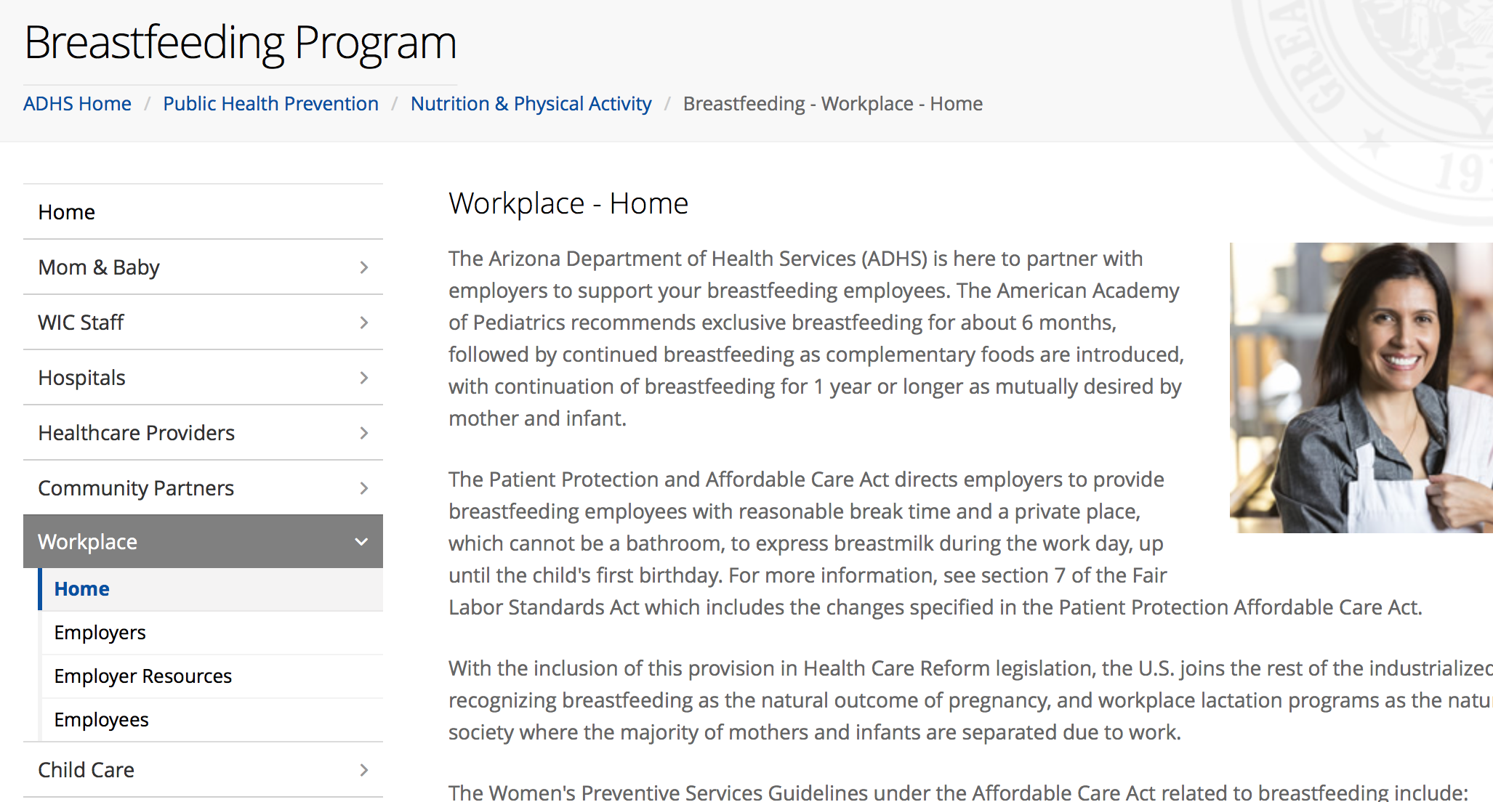
Making it Work Toolkit:
Order online at http://makingitworkarizona.org

Slide 22
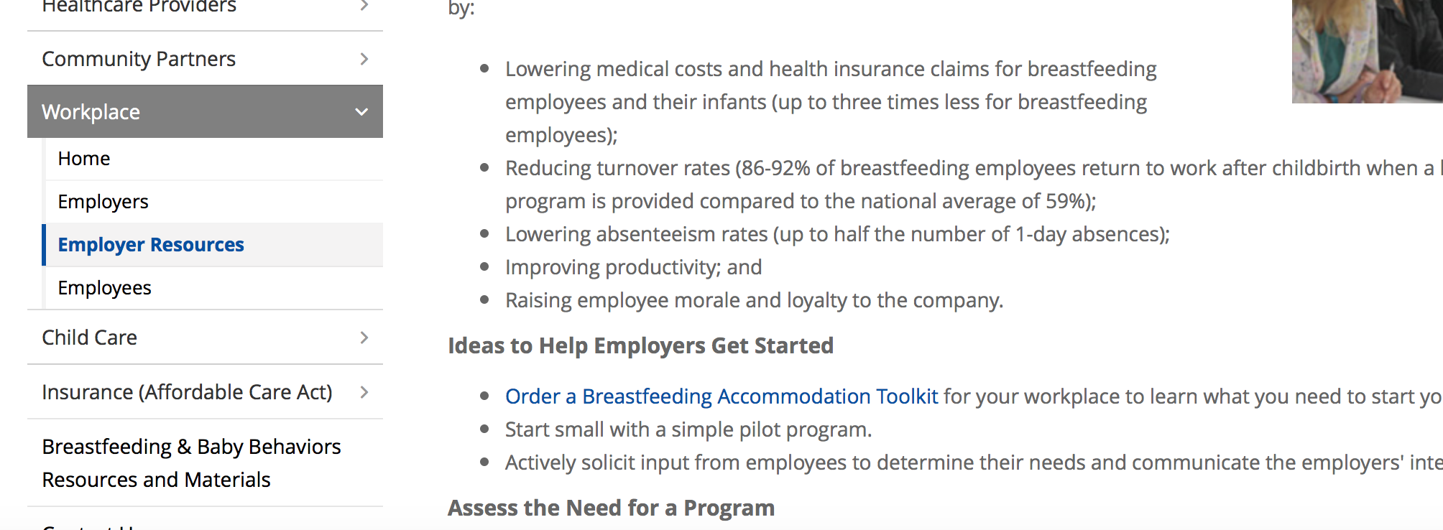
Making it Work Toolkit:
Order online at http://makingitworkarizona.org

Slide 23
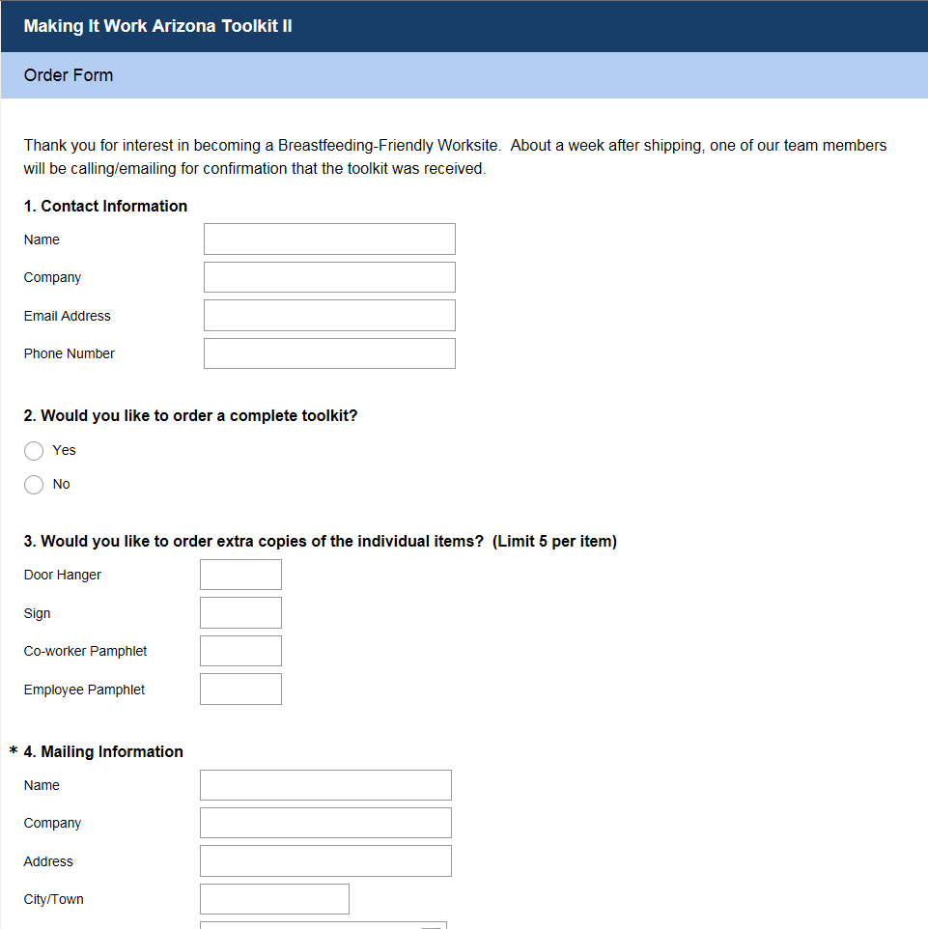
Making it Work Toolkit:

Slide 24
Others Resources
  For Employers and Employees:
    The Business Case for Breastfeeding: Steps for Creating a Breastfeeding Friendly Worksite
    The Surgeon General's Call to Action to Support Breastfeeding
    Office of Women’s Health U.S. Department of Health and Human Services, Support Nursing Moms at Work: Employer Solutions
    Making it Work Toolkit, BreastfeedingPartners.org
    CDC Healthier Worksite Initiative, Workplace Lactation Support Program Toolkit
    National Conference of State Legislatures Compilation of State Breastfeeding Laws
    U.S. Breastfeeding Committee, Workplace Support and Coalitions Directory
    International Lactation Consultants Association, Find a Lactation Consultant Directory
    EEOC Enforcement Guidance: Unlawful Disparate Treatment of Workers with Caregiving Responsibilities

Slide 25

Simple Steps to Compliance:
  Review your company policies and revise as needed
Standard policies ensure:
Equal treatment of all employees
Awareness of all employees
Legitimacy of lactation program within the company
Sustainability of lactation program
If no policy currently exists, create one!

Slide 26
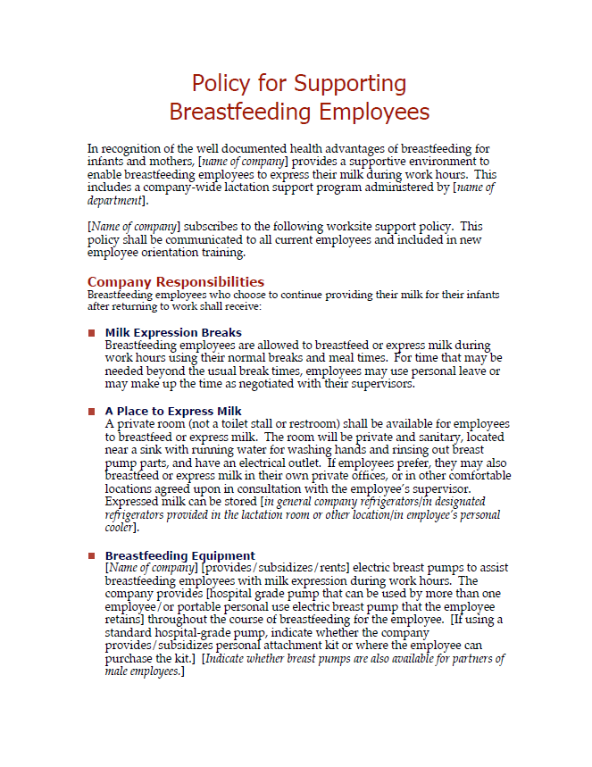
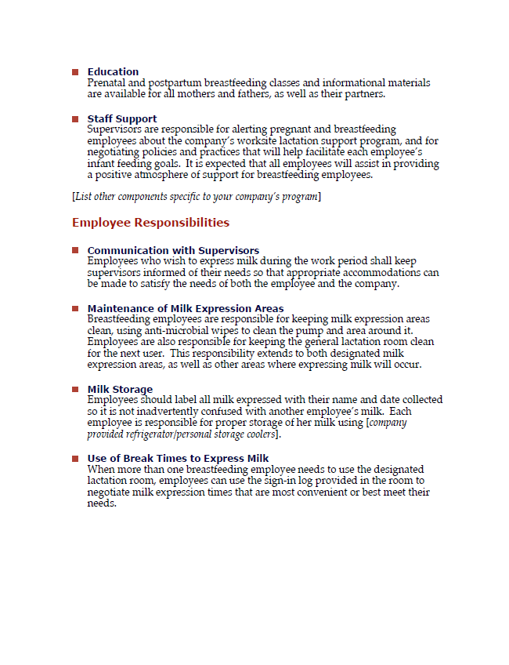
Sample Policy:
Available from the US Department of Health and Human Services Office of Women’s Health

Slide 27


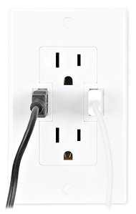
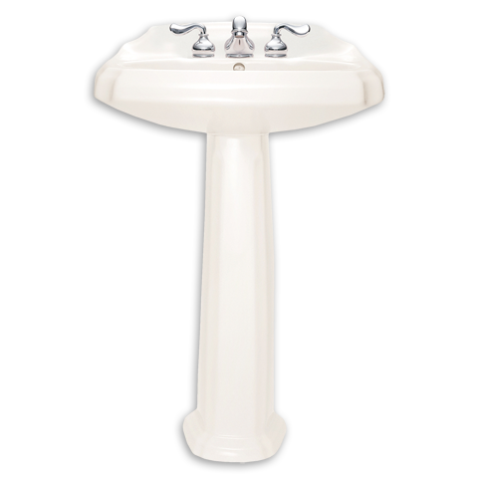

Simple Steps to Compliance:
  Identify space and time options that comply with the law
Additional Room Needs (not required by law):
Chair
Flat surface for breast pump
Located near running water
Electrical outlet for plugging in breast pump
Door that can be secured or sign for privacy and covered windows
Refrigerator for storing for breast milk
Ex. Employee’s own office, office of a co-worker or supervisor, conference room, etc.

Slide 28
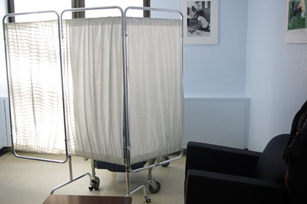
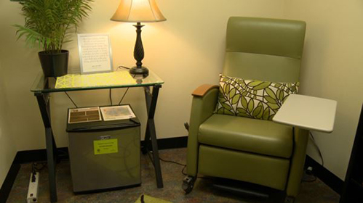
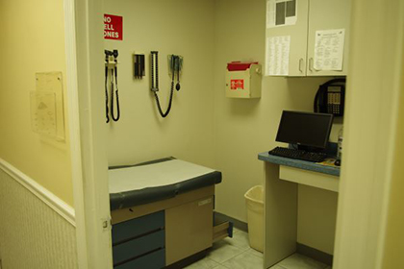
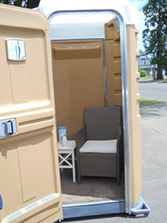
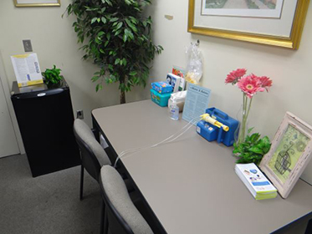
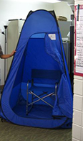
Examples:
More examples available at Womenshealth.gov
All photos obtained from http://www.womenshealth.gov/breastfeeding/employer-solutions/common-solutions/solutions.html

Slide 29
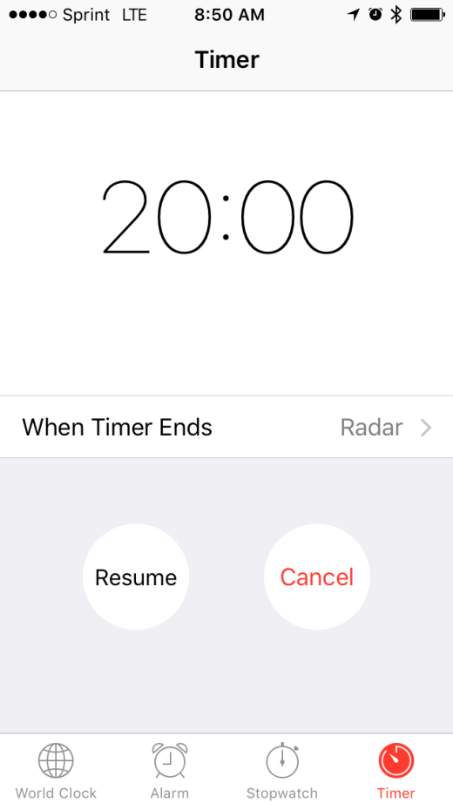
Simple Steps to Compliance:
  Identify space and time options that comply with the law
Time Needs
About 15-20 minutes to express milk, must be taken every 2-3 hours
Options if additional time is needed: using unpaid time, coming in early or staying late, taking shorter meal period, etc.

Slide 30

Simple Steps to Compliance:
  Train supervisors and coworkers on the laws and company policies
Provide information for all employees on laws and policies to assure everyone is on the same page
Send out educational materials
Review company policy
Include as part of new hire orientation

Slide 31

Simple Steps to Compliance:
  Promote your lactation support services
Encourage mothers to make use of the lactation accommodations
Post signs outside of lactation room and information in the break room
Consider offering incentives such as lactation support classes for employees
Photos from Geary County WIC Pinterest Page obtained from https://www.pinterest.com/pin/377950593699351601/

Slide 32
Employer’s Checklist:
  Discuss company’s lactation policy for supporting nursing women prior to maternity leave
  Praise the mother and tell her you support her decision
  Assure that her direct supervisor and other relevant managers are aware of her needs
  Review the employee’s typical work/break schedule to arrange for milk expression breaks
  Arrange for coverage while she is away, if needed
  Identify private space for milk expression
  Assure that a proper storage location for expressed milk is available
  Seek feedback from the employee and her supervisor

Slide 33


Key Points to Remember
  Breast is Best!
  Employers must provide reasonable break time and a place to express milk
  All workplaces are different, find a space that works for your workplace
  Establishing a supportive environment and being transparent about your breastfeeding policies will help your program succeed
  Utilize the resources at your disposal

Slide 34

Questions?

Slide 35


Contact Information
Jessa Zuck
Dietetic Intern
Graduate Student- Nutrition, MS
Jessa.Zuck@asu.edu
(612)-559-9234

Slide 36
References
Arizona Department of Health Services. (n.d.). Breastfeeding Program. Retrieved March 25, 2016, from http://azdhs.gov/prevention/nutrition-physical-activity/breastfeeding/index.php#workplace-home
Breastfeeding Coalition of Oregon. (n.d.). Business case for Breastfeeding: High-yield Return on Investment. Retrieved March 25, 2016, from www.breastfeedingor.org/employer/return-on-investment/
BreastfeedingPartners.org. (n.d.). Making it Work Toolkit. Retrieved March 25, 16, from http://www.breastfeedingpartners.org/index.php?option=com_content&view=article&id=164&Itemid=411
Centers for Disease Control and Prevention. (2010, January 6). Healthier Worksite Initiative: Lactation Support. Retrieved March 25, 2016, from http://www.cdc.gov/nccdphp/dnpao/hwi/toolkits/lactation/index.htm
Centers for Disease Control and Prevention. (2015, August 25). Breastfeeding Report Cards. Retrieved March 25, 2016, from http://www.cdc.gov/breastfeeding/data/reportcard.htm
National Conference of State Legislatures. (2015, December 22). Breastfeeding State Laws. Retrieved March 25, 2016, from www.ncsl.org/research/health/breastfeeding-state-laws.aspx
Office of the Surgeon General. (2011). The Importance of Breastfeeding - The Surgeon General's Call to Action to Support Breastfeeding. Retrieved from http://www.ncbi.nlm.nih.gov/books/NBK52687/
Office of Women's Health. (2008). The Business Case for Breastfeeding. Retrieved March 25, 2016, from http://www.womenshealth.gov/breastfeeding/government-in-action/business-case-for-breastfeeding/business-case-for-breastfeeding-for-business-managers.pdf
Office of Women's Health. (2014, June 23). Supporting Nursing Moms at Work: Employer Solutions. Retrieved March 25, 2016, from http://www.womenshealth.gov/breastfeeding/employer-solutions/index.html
Stanford Children's Health. (n.d.). Newborn-Reflexes. Retrieved March 25, 2016, from http://www.stanfordchildrens.org/en/topic/default?id=newborn-reflexes-90-P02630
United States Department of Labor. (n.d.). Break Time for Nursing Mothers - Wage and Hour Division (WHD) - U.S. Department of Labor. Retrieved March 25, 2016, from http://www.dol.gov/whd/nursingmothers
United States Department of Labor. (n.d.). Wage and Hour Division (WHD). Retrieved March 25, 2016, from http://www.dol.gov/whd/nursingmothers/Sec7rFLSA_btnm.htm

Slide 37
Resources
The Business Case for Breastfeeding: Steps for Creating a Breastfeeding Friendly Worksite
The Surgeon General's Call to Action to Support Breastfeeding
Office of Women’s Health U.S. Department of Health and Human Services, Support Nursing Moms at Work: Employer Solutions
Making it Work Toolkit, ADHS
Making it Work Toolkit, BreastfeedingPartners.org
CDC Healthier Worksite Initiative, Workplace Lactation Support Program Toolkit
National Conference of State Legislatures Compilation of State Breastfeeding Laws
U.S. Breastfeeding Committee, Workplace Support and Coalitions Directory
International Lactation Consultants Association, Find a Lactation Consultant Directory
EEOC Enforcement Guidance: Unlawful Disparate Treatment of Workers with Caregiving Responsibilities
Sample Breastfeeding Policy, US Department of Health and Human Services Office of Women’s Health

